Slide 1
College Student Leadership

Slide 2
Welcome
Gordon Maloney, NUS Scotland President

Slide 3
Welcome
Protocol video

Slide 4
Housekeeping
Tutor rooms and plenary
Fire alarms
Toilets
Be on time
If you leave the event you must tell a member of NUS or sparqs staff
Conference phone number: 07515575373
Dinner and evening
Accommodation
Photos

Slide 5
Tutor groups
Stephanie’s Group:
Angela Alexander
Mark McCafferty
Sanjay Lago
Conor McLeod
Myles McCallum
Jennifer Bethan
Kara Gravells
Siobhan Carmichael
Justine Coulter
Andrew Aitken
Julia Fitzgerald
Lorraine Simpson

Slide 6
Tutor Groups
Natalie’s Group:
Sophie Brooks
Xander McDade
Briony Dall
Sharon Graham
Brian Jamieson
Samuel Glendinning
Eire Hawthorn
Lizzie Munro
Ahley Hickford
Marc Winsland
Zoe Croy
David Rennie

Slide 7
Tutor groups
Charlotte’s Group:
Emma Hall
Hannah Morley
Jeroen Van Herk
Deborah Jackson
Connor Farmer
Diane Erasmusen
Michelle Bingham
Alex Robb
Declan McCrossan
Maria Roberts
Conor Neill
John Dare

Slide 8
Welcome to your tutor group

Slide 9
So…you’re now a student leader

Slide 10
Learning objectives
Reflect on why you became a student leader
Start to identify what you want to achieve in your year in office
Get to know your tutor group
Create ground rules for the group for the rest of the course

Slide 11
Ground rules
As a group you will set the ground rules for the rest of the course

Slide 12
Icebreaker- Shield exercise
Draw four sections in your shield and answer the following questions:
Why you wanted to be a student leader
One thing you want to change in their college
One thing that worries you about the year ahead
The most worthwhile thing you have ever done.

Slide 13
So…….now you are a Student Leader
In this session you will:
Reflect on why you became a student leader
Start to identify what you want to achieve in your year in office
Get to know your tutor group
Create ground rules for the group for the rest of the course

Slide 14
The College context – setting the scene

Slide 15
Learning objectives
By the end of the session, participants will:
be able to explain the complexity within the college sector;
understand the policy behind recent changes to the college sector;
be able to explain the current college structures and what changes are ongoing; and
have identified potential opportunities for involvement and where they can make a change.

Slide 16
Aim of regionalisation
The Scottish Government wanted to improve:
how our colleges are funded.
how the sector is structured.
the type of educational and training opportunities colleges provide.
the quality of that provision.
colleges’ accountability.

Slide 17
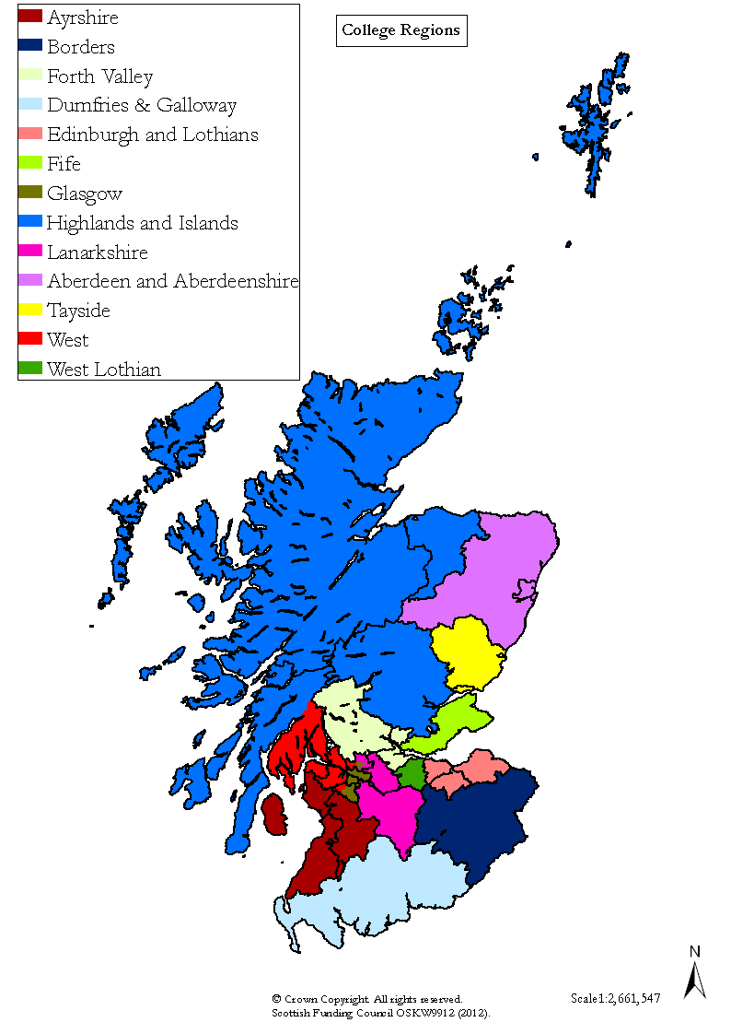
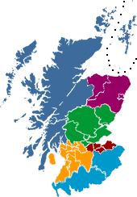
The regions
Highlands & Islands
Aberdeen & Aberdeenshire
Tayside
Forth Valley
Fife
West
West Lothian
Glasgow
Edinburgh & Lothians
Ayrshire
Lanarkshire
Dumfries & Galloway
Borders

Slide 18
Next steps
Post-16 Education (Scotland) Act 2013
Changes to:
the support available to colleges;
college governance;
how colleges are reviewed; and
how information about young people's involvement in education and training is shared.

Slide 19
Next steps
Recommendation 23

Slide 20
College planning
Strategic Plan.
Outcome Agreement.
Student Partnership Agreement.

Slide 21
Learning objectives
By the end of the session, participants will:
be able to explain the complexity within the college sector;
understand the policy behind recent changes to the college sector;
be able to explain the current college structures and what changes are ongoing; and
have identified potential opportunities for involvement and where they can make a change.

Slide 22
Regionalisation
Highlands & Islands
Aberdeenshire
Fife
Tayside
Glasgow
West
Ayrshire
Dumfries & Galloway
Edinburgh & Lothians
West Lothian
Forth Valley

Slide 23
Aim of regionalisation
The Scottish Government wanted to improve:
how our colleges are funded.
how the sector is structured.
the type of educational and training opportunities colleges provide.
the quality of that provision.
colleges’ accountability.

Slide 24
The regions
Aberdeen and North East
Highlands and Islands
Fife
Edinburgh & Lothians
Glasgow
Dumfries & Galloway
Borders

Slide 25
Engagement and representation in Colleges

Slide 26
Learning objectives
By the end of the session, you will:
have identified quality processes and mechanisms within their college that they could utilise;
recognise national influences on quality within the college; and
have identified if and how to use the quality processes to achieve on their
manifesto commitments.

Slide 27
College Quality Partners

Slide 28
Student Engagement Framework for Scotland
There are five key elements:
Students feeling part of a supportive institution.
Students engaging in their own learning.
Students working with their institution in shaping the direction of learning.
Formal mechanisms for quality and governance.
Influencing the student experience
at national level.

Slide 29
Student Engagement Framework for Scotland
There are six features:
A culture of engagement.
Students as partners.
Responding to diversity.
Valuing the student contribution.
Focus on enhancement and change.
Appropriate resources and support.

Slide 30
Why is representation important?
Student
views
Dialogue
with staff
Improved learning
experience
STUDENTS ARE THE EXPERTS!

Slide 31
Learning objectives
By the end of the session, you will:
have identified quality processes and mechanisms within their college that they could utilise;
recognise national influences on quality within the college; and
have identified if and how to use the quality processes to achieve on their manifesto commitments.

Slide 32
Shifting the balance of power

Slide 33
Learning objectives
Identify the power structures within society
Identify power in the College structure
Identify how they can use the power of their role to create social change using the ‘upside down triangle’ theory of power

Slide 34
Who gives people their power?
‘By themselves, rulers cannot collect taxes, enforce repressive laws and regulations, keep trains running on time, prepare national budgets, direct traffic, manage ports, print money, repair roads, keep markets supplied with food, make steel, build rockets, train the police and army, issue postage stamps or even milk a cow. People provide these services to the ruler through a variety of organisations and institutions. If people would stop providing these skills,
the ruler could not rule.’
Gene Sharp, The Politics of Non-violent Action

Slide 35
Bad news – good news
Bad news
With great power comes great responsibility
Good news
You have the power to flip the triangle!
You can create an association where underrepresented students are empowered to create change

Slide 36
Flipping the triangle upside down
Recognising your power
Realising your advantages in society in some ways
Using this to take responsibility to ensures that the voice of students is championed and given the platform it needs to make real change and impact to their education and society.

Slide 37
Learning objectives
Identify the power structures within society
Identify power in the College structure
Identify how they can use the power of their role to create social change using the ‘upside down triangle’ theory of power

Slide 38
The role of the student leader

Slide 39
Learning objectives
Explore the three main styles of leadership
Discuss the benefits and drawbacks of these different styles
Explore the definition of a student leader
Discuss the relevance of the Digby Jacks quote in relation to your role

Slide 40
Leadership styles
Autocratic
Democratic
Laissez-faire

Slide 41
Task what makes a student leader?
Write a definition of what makes a good student leader on a post it

Slide 42
Task
In two groups:
Draw the ideal student leader, including what characteristics they would require.

Slide 43
Representation must never be seen…as an end in itself. Too many union officers see it as a question of communication and merely sitting on an appropriate committee.
The purpose of representation is to secure educational and institutional change.’
Digby Jacks, 1974

Slide 44
Learning objectives
Explore the three main styles of leadership
Discuss the benefits and drawbacks of these different styles
Explore the definition of a student leader
Discuss the relevance of the Digby Jacks quote in relation to your role

Slide 45
Welcome back
Day One refresher

Slide 46
What do you want to change this
year?

Slide 47
Learning objectives
Identify their political ideas and principles
Explore the similarities and differences within the group
Understand NUS’ policy direction
Think about areas that they would like to be involved in NUS

Slide 48
What do you think?
Education should be aimed solely at supporting specific outcomes such as going on to further training or into a job

Slide 49
What do you think?
Exams should take place only once a year, in the summer term. Lots of exams and assessments are disruptive

Slide 50
What do you think?
I believe that in life and education, if you work hard you will be able to achieve anything you want. We may have different backgrounds but we start off as equals as far as education is concerned and what you make of yourself is totally up to you and no-one else.

Slide 51
What do you think?
Our education system works for students in the 21st century

Slide 52
What do you think?
Our institutions have a responsibility to make our society better

Slide 53
What do you think?
Students are prepared well during their education for the world of work

Slide 54
What do you think?
Student parents should have access to publicly funded childcare whilst they are in education.

Slide 55
Influencing NUS

Slide 56
Learning objectives
Design a perfect holiday for everyone
Learn a little about NUS democracy along the way!

Slide 57
NUS policy
Set of instructions and beliefs that NUS has that directs our work
We need policy so we know what students think about major issues

Slide 58
We’re all going on a summer holiday
Task 1
Take 5 minutes to describe your ideal holiday and jot it down. Include location and length, the sort of weather you’d like and any activities you want to do.

Slide 59
But…we’re ALL going on holiday
Task 2
Few people like to holiday alone and also we need to go on a single holiday together
In your groups – try and come together so that there’s a single holiday plan for all of you. This means changing your plans to fit in with each other
You cannot vote to make a decision
You have 10 minutes

Slide 60
Your ideal group holiday
What was it like having to debate and make comprises?
Having space to share ideas and common thoughts is an important part of making decisions. Debating and trying to change each other’s minds is useful.

Slide 61
Elections
Task 3
You have 5 minutes to choose someone from your group to present your team’s idea for a holiday together
You can vote for the person if you like
Task 4
That person now needs to go to a different group and spend 5 minutes presenting your team’s idea

Slide 62
Decision time!

Slide 63
Vote!

Slide 64
NUS democracy
Believe it or not, you have just followed through the process of getting your ideas discussed at NUS Conference
You will be talking about things like vocational education or student support rather than holidays, but the process is the same.

Slide 65
NUS democracy
All students have their own ideas on policy
Task one (your ideal holiday)
Zone Conference in October debate informally
Task two (group holiday). No voting involved
You elect a delegation to make a suggestion
- Task three (election) and Task four – feedback to another group

Slide 66
NUS democracy
Students’ associations come together and ‘pitch’ their ideas to each other, other students’ associations can add bits or change bits.
Students’ associations vote for the ideas they like

Slide 67
Making change happen for your students

Slide 68
Session objectives
Know what a campaign is
Identify problems you’d like to campaign on
Find the roots of these problems
Identify solutions to these problems
Create a SMART campaign aim

Slide 69
What is a campaign?
“organised actions around a specific issue seeking to bring about changes in the policy and behaviours of institutions and/or specific public groups…the mobilising of forces by organisations to influence others in order to effect an identified and desired social, economic, environmental or political change.”
NCVO (National Council for Voluntary Organisations)

Slide 70
Problem tree
Consequences
Problem
Roots

Slide 71
Solution tree
Effects
Vision
Actions
Notes:
‘Now we’re going to turn your problem trees into solutions trees’.

Slide 72
Which is the most effective campaign aim?
‘Better feedback’
‘The university/college to commit to a maximum of 3 weeks turnaround on written assessment’

Slide 73
SMART campaigning
Specific
Relevant
Measurable
Time bound
Achievable

Slide 74
Session objectives
Know what a campaign is
Identify problems you’d like to campaign on
Find the roots of these problems
Identify solutions to these problems
Create a SMART campaign aim

Slide 75
Making change happen for your students - plenary

Slide 76
Session objectives
Understand the importance of involving students in your campaigns
Identify key stages to get students involved in campaigning
Explore techniques of how to get students involved in your campaigns
Consider how you will involve students in your campaigns

Slide 77
Effective campaigns cycle
Analyse the issue
Developing Strategy
Planning
Campaign Delivery and Monitoring
Evaluate
Notes:
When you’re taking these actions it’s important to keep monitoring the campaign to make sure you’re on the right track. It could be that something happens or you reach part of your goal and you need to re-evaluate your strategy – this is where monitoring comes in.
Evaluate – at the end of your campaign it’s useful to evaluate how successful your campaign was. What went wrong, what worked particularly well and how to use this in future campaigns. Then the cycle starts again with the next issue.

Slide 78
Campaigning on
your own is
rubbish.

Slide 79
Why involve other people?
Proves it’s a widely felt issue
Makes it harder for the decision maker to ignore
Spreads the campaign message
Brings a range of skills and idea
Many hands make light work
Can influence different groups of people
Helps you test you’re on the right track
Keeps everyone motivated

Slide 80
Effective campaigns cycle
Build relationships
Identify campaign issue
Analyse the issue
Develop a strategy
Planning
Organise and build
Campaign delivery and monitoring
Evaluation
Notes:
Analyse the issue – looking at problems and what is leading up to them – this is where the problem tree is useful
Developing the strategy – this is the solution tree and looking at what we could do about it, and setting our SMART campaign aim
Planning – this is where we start thinking about our allies, who to get involved, who it is that has the power to make the change, plan what actions you are going to take and who you can get involved
Campaign delivery – this is where the actions take place whether that be stunts, petitions, lobbying meetings or press releases about the issue. When you’re taking these actions it’s important to keep monitoring the campaign to make sure you’re on the right track. It could be that something happens or you reach part of your goal and you need to re-evaluate your strategy – this is where monitoring comes in.
Evaluate – at the end of your campaign it’s useful to evaluate how successful your campaign was. What went wrong, what worked particularly well and how to use this in future campaigns. Then the cycle starts again with the next issue.

Slide 81
Build relationships
1-2-1s
Storytelling
- Challenge
- Choice
- Outcome
- Moral
Further 1-2-1s
Notes:
You develop a network of people, who know other people and can bring them along.
Let’s take this to the side for a minute and think about how this might be relevant or useful in other areas of your work in the students’ association.

Slide 82
Identify campaign issue
1-2-1s
Listening exercise
Involve those who are interested in the campaign planning
Notes:
You could use this as well as campaigning but also in other parts of your work as a student officer. For example around issues that are brought up in class. You could also train class representatives in these techniques.

Slide 83
Effective campaigns cycle
Build relationships
Identify campaign issue
Analyse the issue
Develop a strategy
Planning
Organise and build
Campaign delivery and monitoring
Evaluation
Notes:
Analyse the issue – looking at problems and what is leading up to them – this is where the problem tree is useful
Developing the strategy – this is the solution tree and looking at what we could do about it, and setting our SMART campaign aim
Planning – this is where we start thinking about our allies, who to get involved, who it is that has the power to make the change, plan what actions you are going to take and who you can get involved
Campaign delivery – this is where the actions take place whether that be stunts, petitions, lobbying meetings or press releases about the issue. When you’re taking these actions it’s important to keep monitoring the campaign to make sure you’re on the right track. It could be that something happens or you reach part of your goal and you need to re-evaluate your strategy – this is where monitoring comes in.
Evaluate – at the end of your campaign it’s useful to evaluate how successful your campaign was. What went wrong, what worked particularly well and how to use this in future campaigns. Then the cycle starts again with the next issue.

Slide 84
Organise and build
Develop your campaign team
Involve those you have built relationships with
Bring along a ‘rising star’

Slide 85
Effective campaigns cycle
Build relationships
Identify campaign issue
Analyse the issue
Develop a strategy
Planning
Organise and build
Campaign delivery and monitoring
Evaluation
Notes:
Analyse the issue – looking at problems and what is leading up to them – this is where the problem tree is useful
Developing the strategy – this is the solution tree and looking at what we could do about it, and setting our SMART campaign aim
Planning – this is where we start thinking about our allies, who to get involved, who it is that has the power to make the change, plan what actions you are going to take and who you can get involved
Campaign delivery – this is where the actions take place whether that be stunts, petitions, lobbying meetings or press releases about the issue. When you’re taking these actions it’s important to keep monitoring the campaign to make sure you’re on the right track. It could be that something happens or you reach part of your goal and you need to re-evaluate your strategy – this is where monitoring comes in.
Evaluate – at the end of your campaign it’s useful to evaluate how successful your campaign was. What went wrong, what worked particularly well and how to use this in future campaigns. Then the cycle starts again with the next issue.

Slide 86
The people and the impact
Community organising isn’t a light switch that can go on and off, it’s a particular way of doing things and a commitment to not simply create change, but create leaders and momentum.
It is focusing on the by product being as important as the campaign objective; the people made powerful along the way.
Notes:
Simply put it’s about creating leaders, changing society and people being powerful.

Slide 87
Effective campaigns cycle
Build relationships
Identify campaign issue
Analyse the issue
Develop a strategy
Planning
Organise and build
Campaign delivery and monitoring
Evaluation
Notes:
Analyse the issue – looking at problems and what is leading up to them – this is where the problem tree is useful
Developing the strategy – this is the solution tree and looking at what we could do about it, and setting our SMART campaign aim
Planning – this is where we start thinking about our allies, who to get involved, who it is that has the power to make the change, plan what actions you are going to take and who you can get involved
Campaign delivery – this is where the actions take place whether that be stunts, petitions, lobbying meetings or press releases about the issue. When you’re taking these actions it’s important to keep monitoring the campaign to make sure you’re on the right track. It could be that something happens or you reach part of your goal and you need to re-evaluate your strategy – this is where monitoring comes in.
Evaluate – at the end of your campaign it’s useful to evaluate how successful your campaign was. What went wrong, what worked particularly well and how to use this in future campaigns. Then the cycle starts again with the next issue.

Slide 88
How are you going to
involve students in your campaigns?
Notes:
There’s a time and a place for both. Traditional campaigning suits best when you’ve got an issue already, perhaps that’s a policy that’s gone through your student council, a pledge that you’ve made in your manifesto or a change being proposed in the college that you want to stop and you can still involve students at each of the stages of the campaign. Tends to be quickfire or reactive.
Where community organising techniques work best is when you’re looking to engage students further in the campaigns and to develop leaders. If you don’t have a specific issue in mind to campaign around then building relationships and working with students on campus to develop the issues that are important to them not only empowers them and builds their campaigning skills but is also more sustainable. Can be more proactive and takes time.

Slide 89
Keep in touch!
Jenny Batty, Campaigns Delivery Officer
Jenny.Batty@nus-scotland.org.uk
Lynn Pilkington, Assistant Community Organiser
EdinburghACO@nus.org.uk

Slide 90
Winning the argument for your
students

Slide 91
Learning objectives
In this session you will:
Prepare a short speech
Practice public speaking
Demonstrate a public speaking tip
Deliver a short speech

Slide 92
Your Task
Write a 45 second speech to deliver to the group which is about what you want to change you have been working on that you want to make happen for your students

Slide 93
15 Top Tips
Manage your audience’s attention span | Bring your ideas to life | Primary and regency affect
Hook them from the start | Mesmerise them with your words | The power of words
The audience wants to know… ‘what’s in it for me’ | Anticipate questions | Use powerful words
Help your audience stay on track | Pulling it all together | Apathy staircase
Engage your audience | Be humble | Practice makes perfect!

Slide 94
Learning objectives
In this session you will:
Prepare a short speech
Practice public speaking
Demonstrate a public speaking tip
Deliver a short speech

Slide 95
Planning for the future

Slide 96
Learning objectives
By the end of the session, participants will have:
considered what needs to be done at class/college/national level to fulfil the manifesto commitments;
identified the processes and mechanisms that could inform the action plan;
identified gaps and opportunities for developing student involvement in the planning
process; and created a draft action
plan.

Slide 97
Just a couple more things!
Thank you!
Feedback forms
Certificates
Back into plenary to say goodbye!

Slide 98
Thank you for coming!

